Slide 1
Factors Affecting
Water Consumption
in a Medium Size City

Slide 2
Factors Affecting
Water Consumption
in a Medium Size City

Slide 3


Slide 4
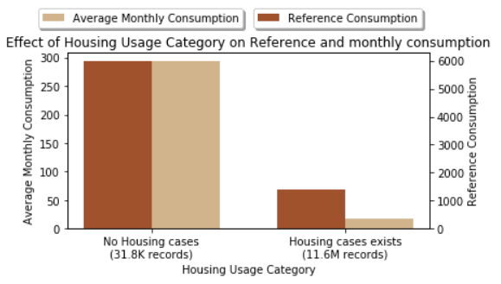
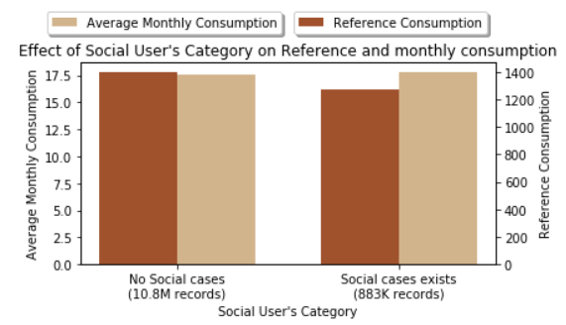
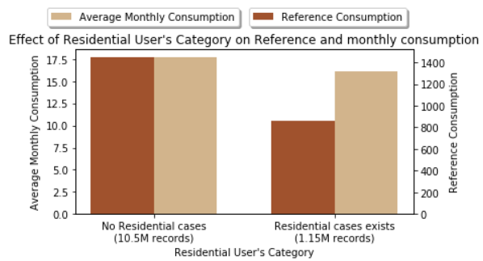
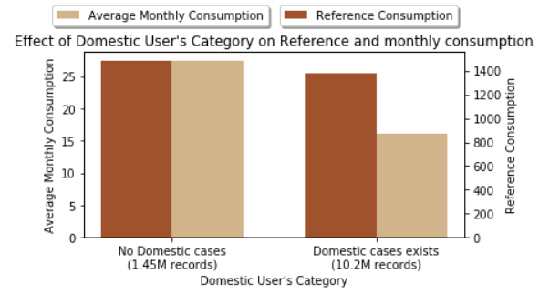
Social
Residential
Domestic

